Slide 1
Online Banking Application

Slide 2
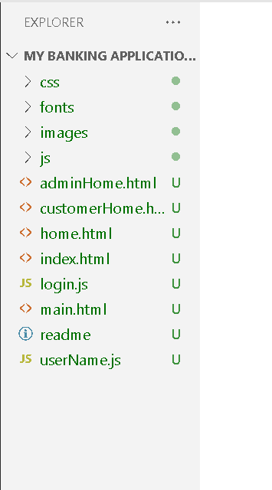
Project structure

Slide 3
Technologies use to develop this projet
Html and html5
Css and css3
JavaScript
Bootstrap
Third party library jQuery and pepper js etc

Slide 4
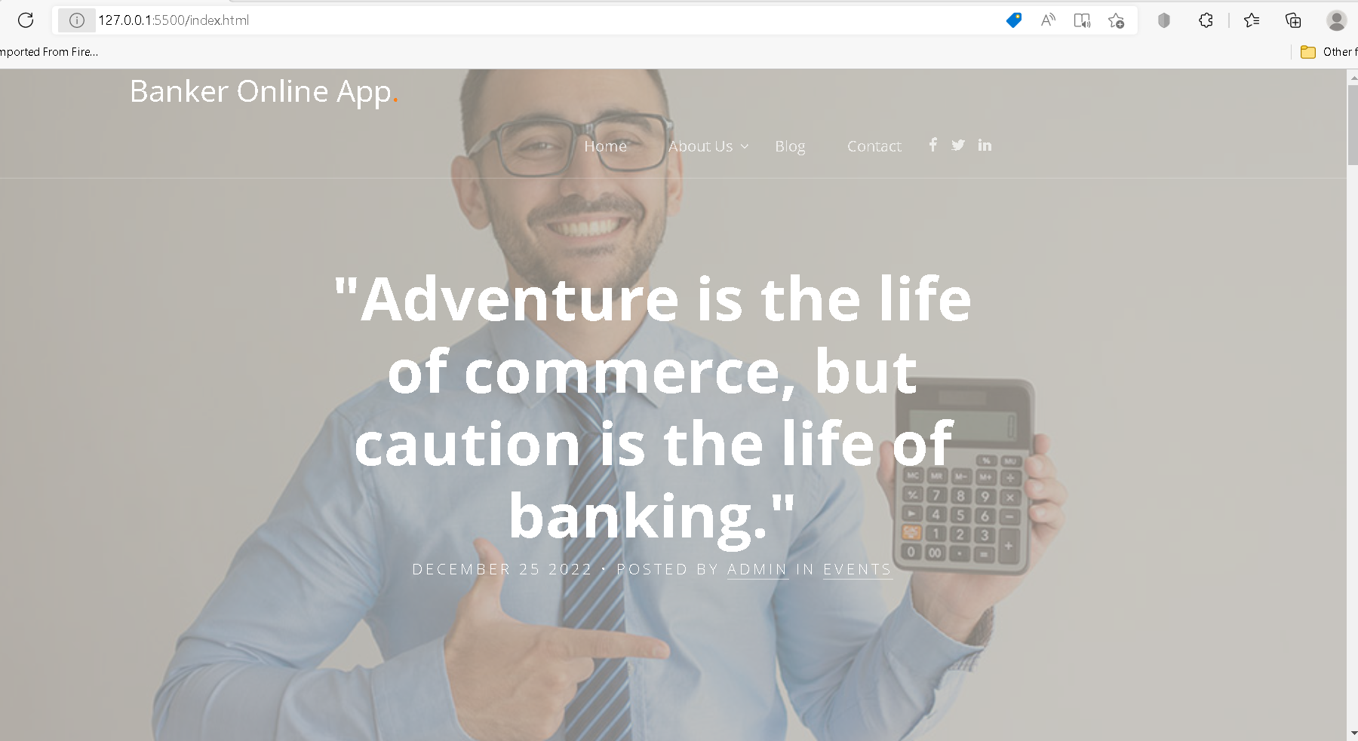
First page of the application is ie index.html

Slide 5
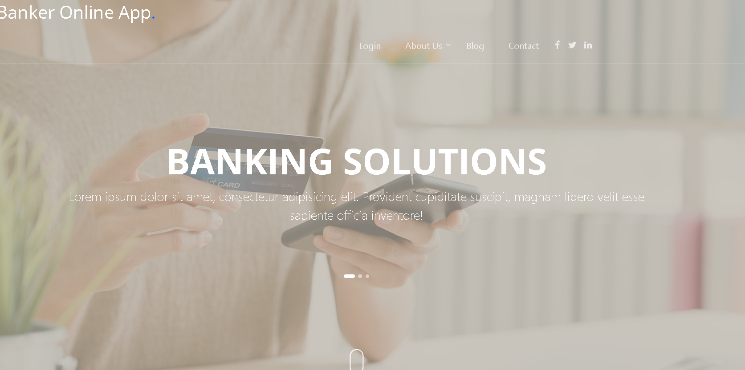
After click on home option

Slide 6
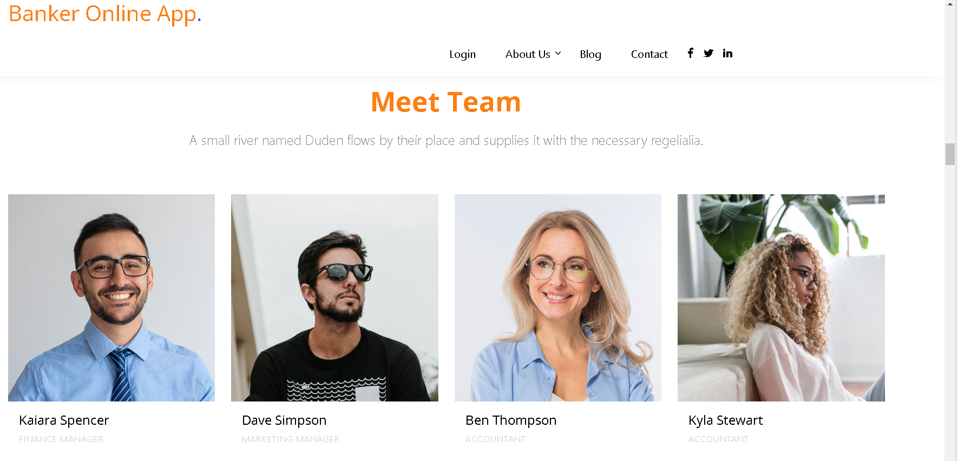
Team option

Slide 7
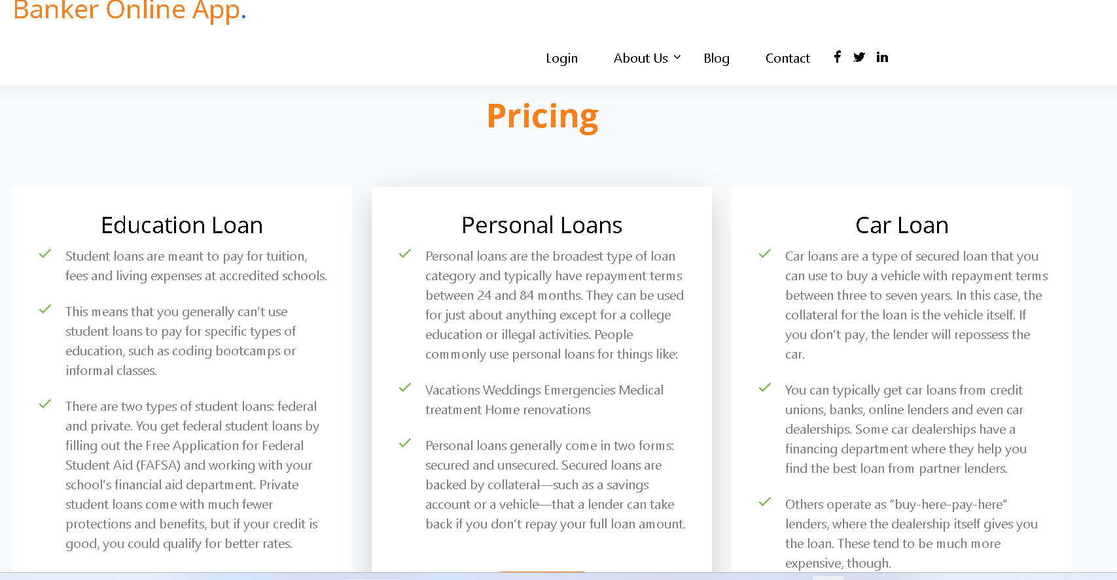
Loan section

Slide 8
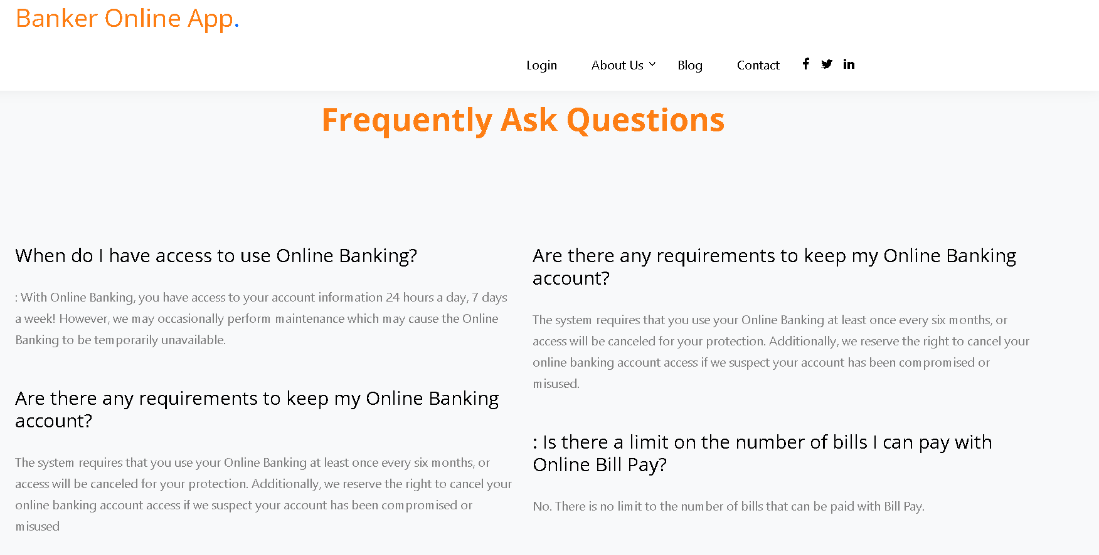
FAQ section

Slide 9
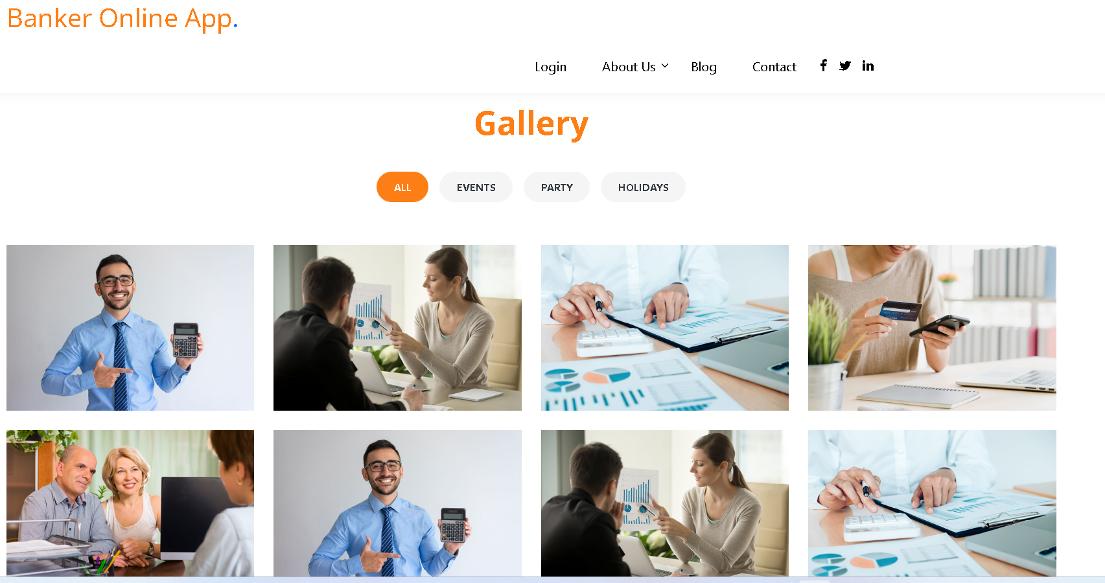
Gallery section

Slide 10
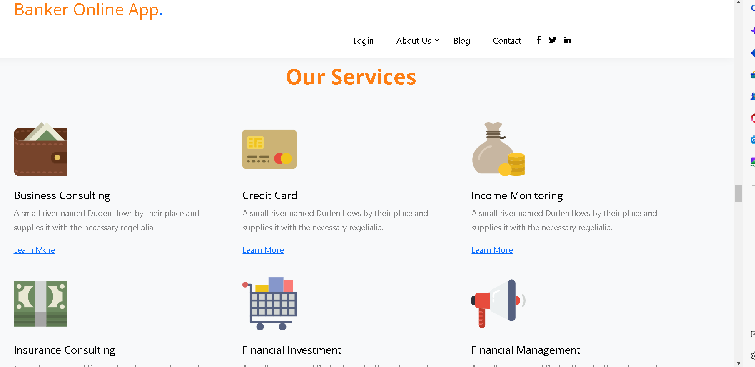
Service section

Slide 11
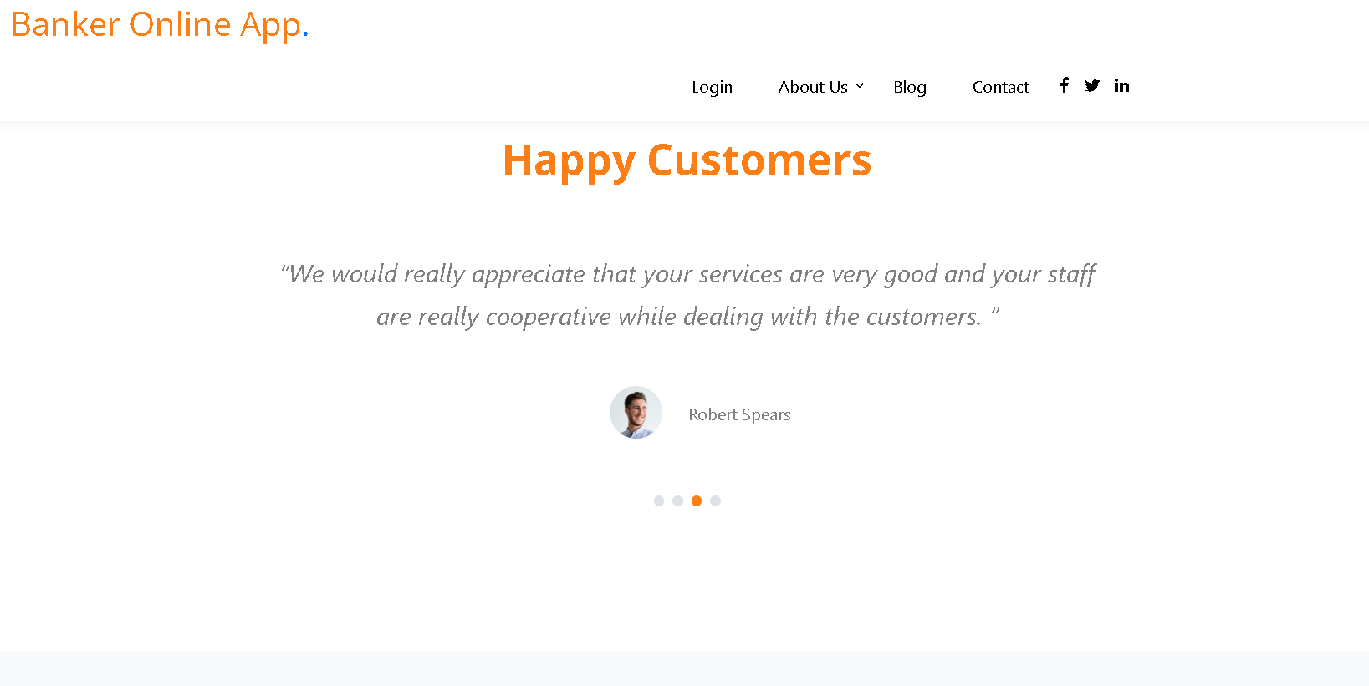
Testimonial section

Slide 12
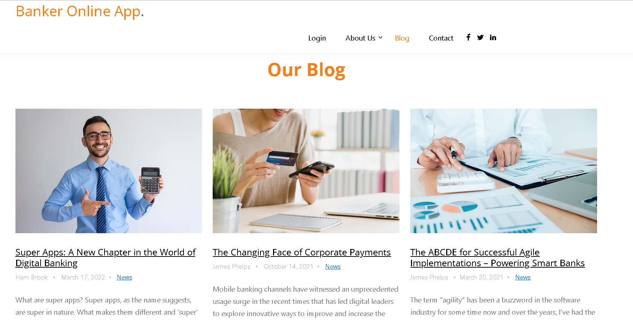
Blog section

Slide 13
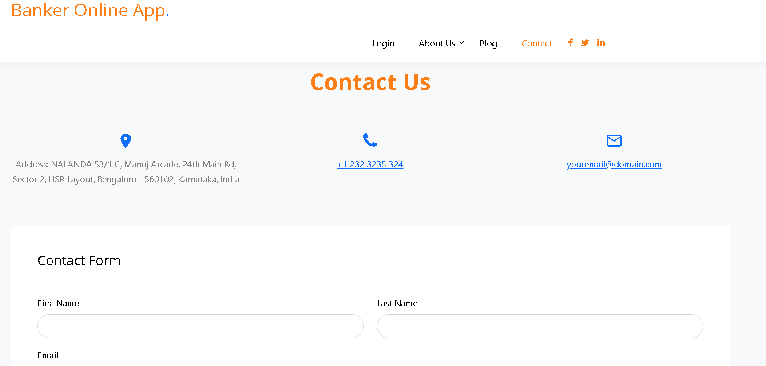
Contact section

Slide 14
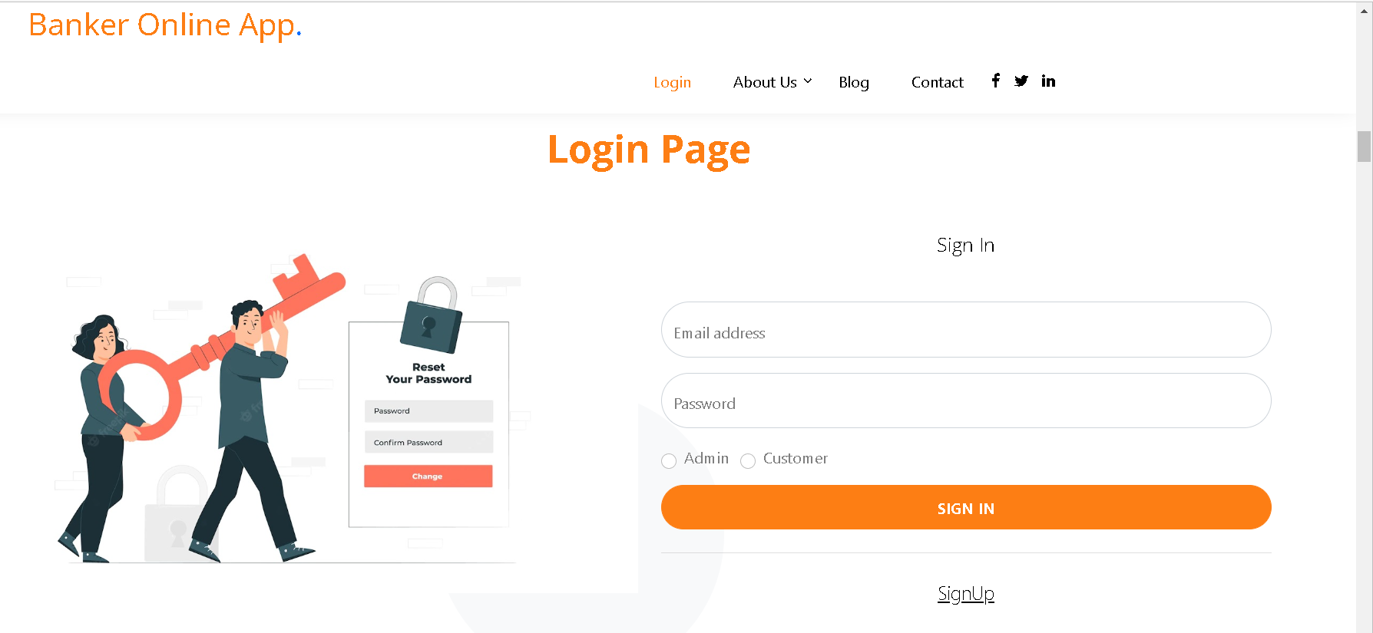
Login for admin as well as customer

Slide 15
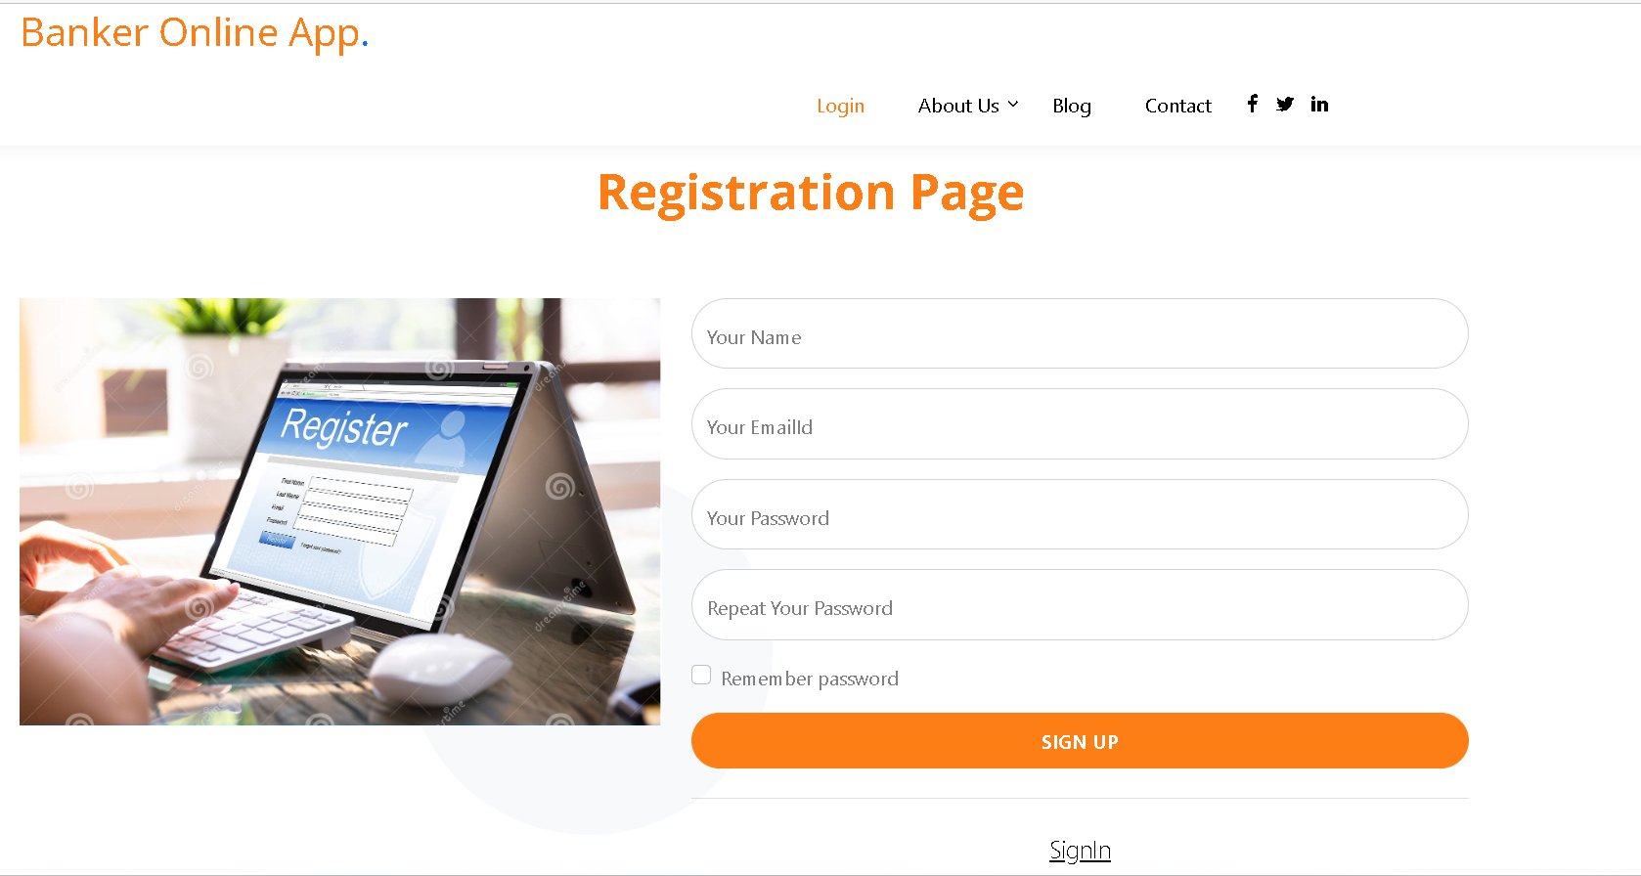
Signup for the customer

Slide 16
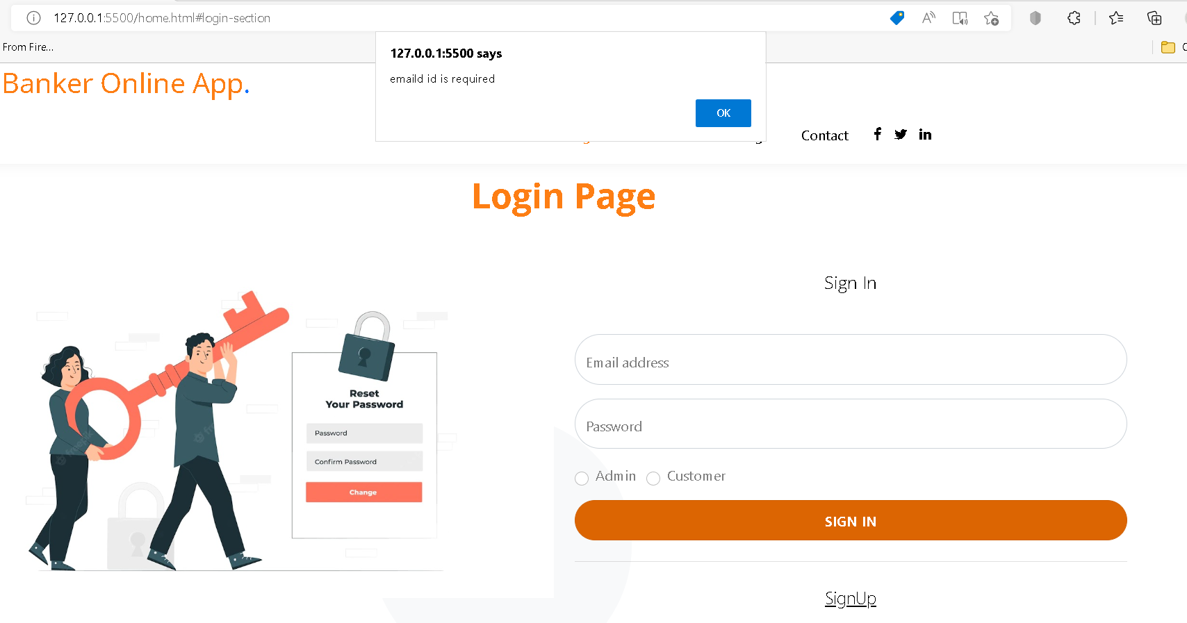
Validation on email id

Slide 17
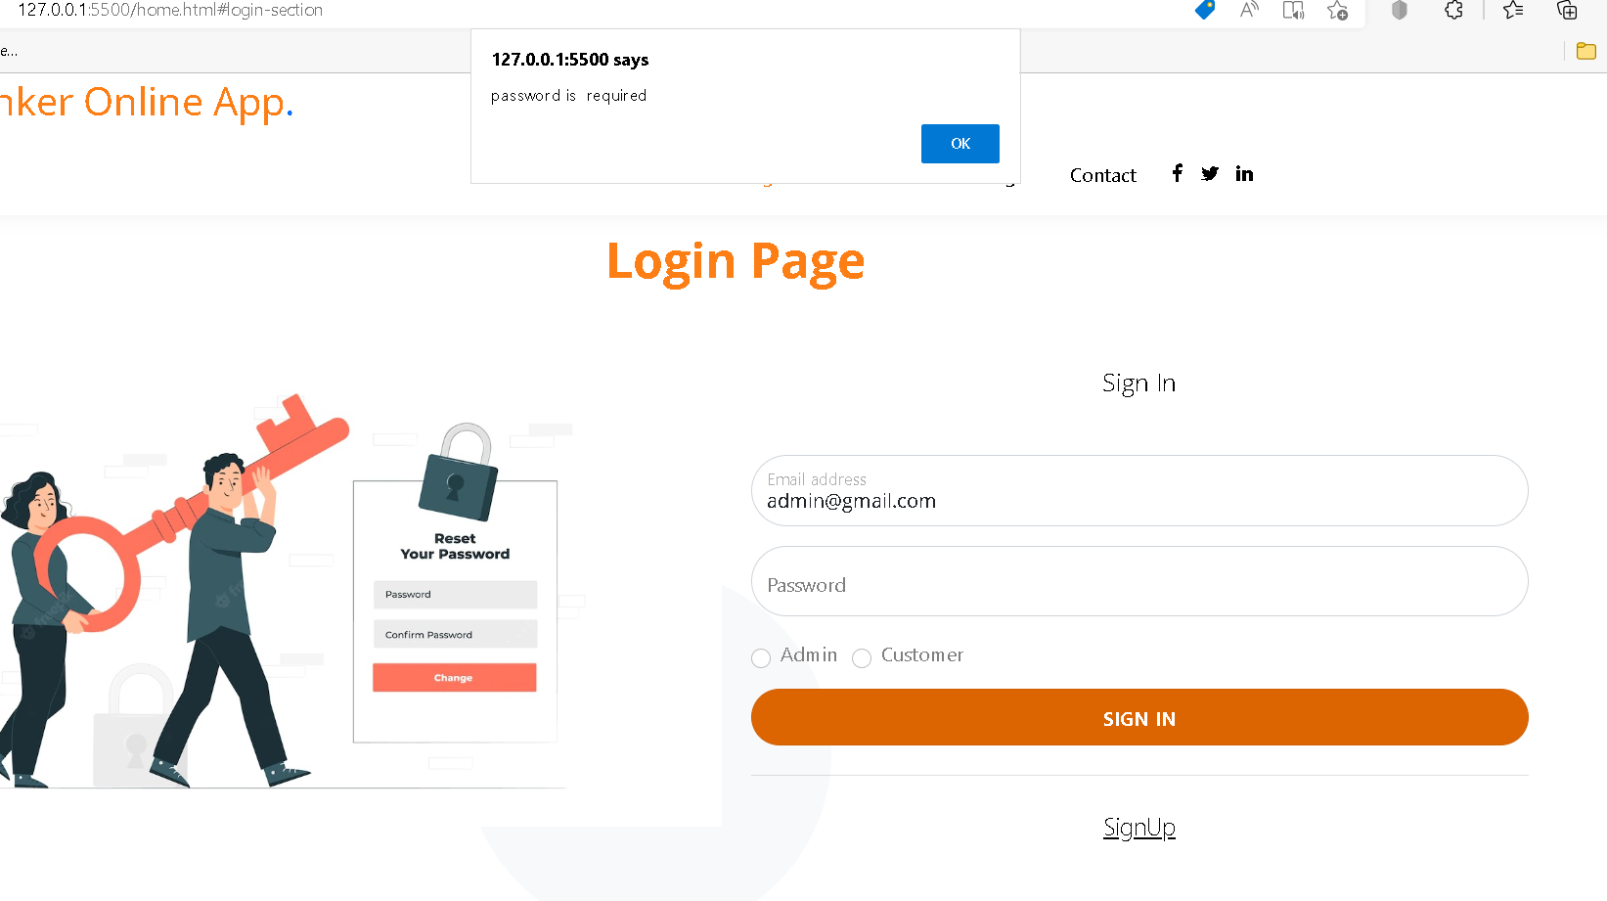
Validation on password

Slide 18
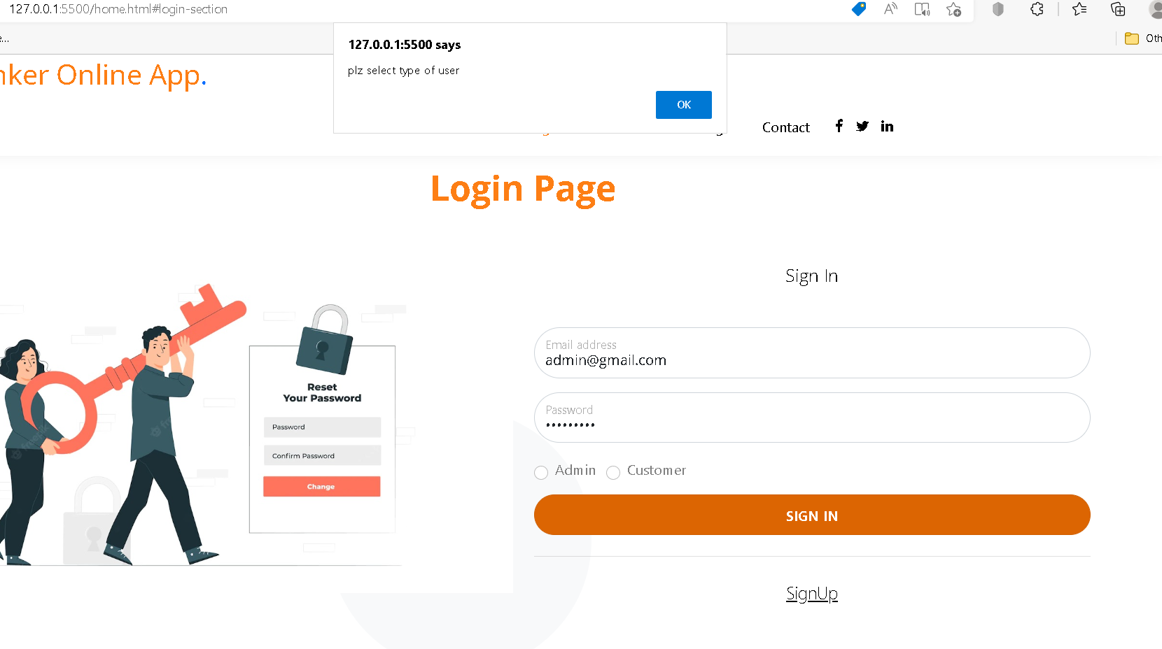
Validation on type of user

Slide 19
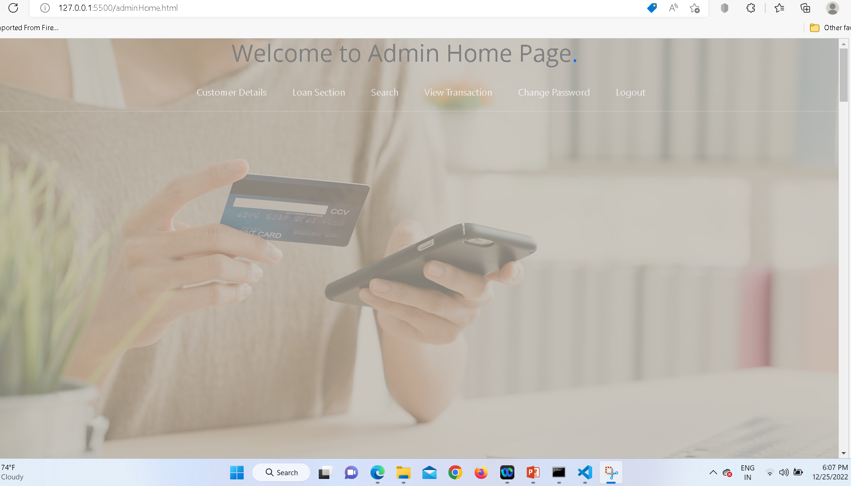
After validation with email id admin@gmail.com and password as admin@123 for admin login

Slide 20
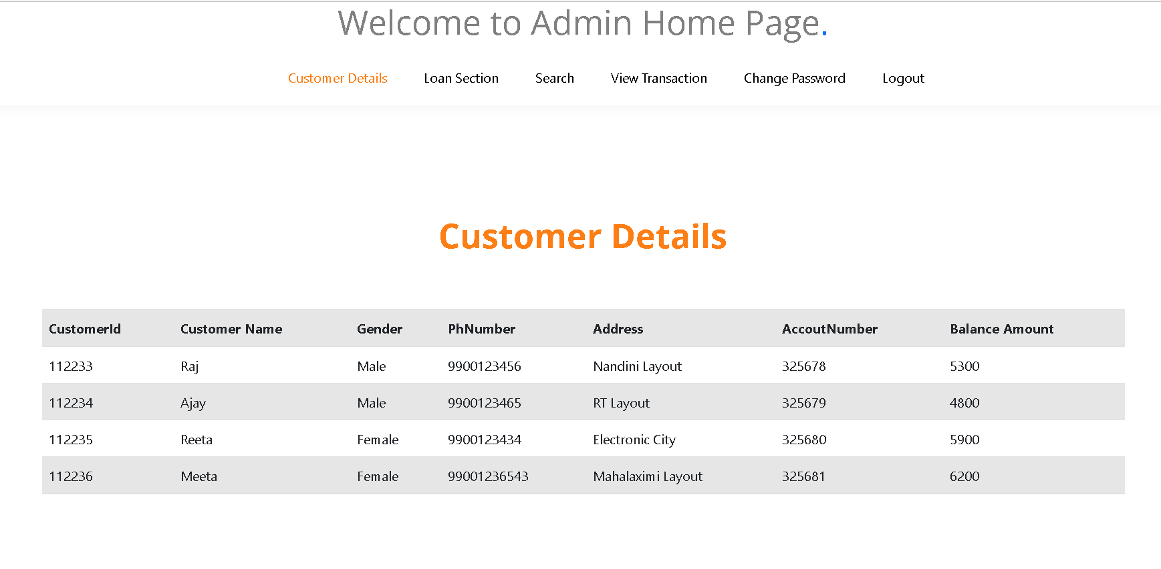
Customer dummy details

Slide 21
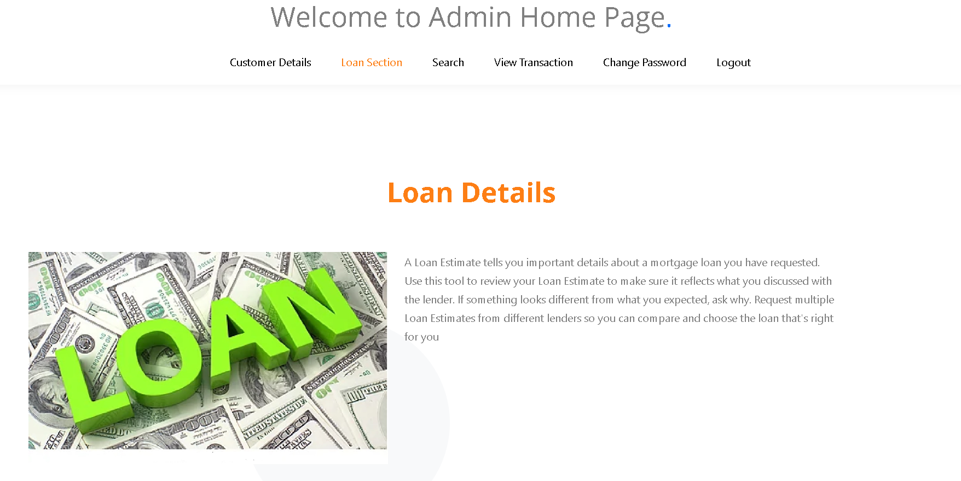
Loan section

Slide 22
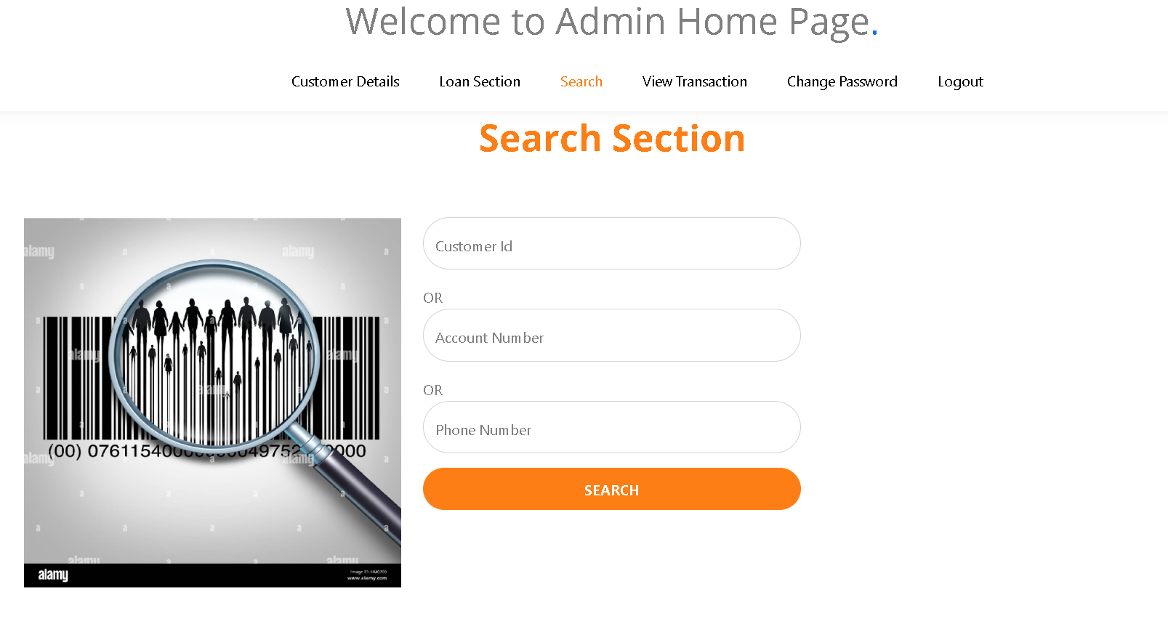
Customer search section

Slide 23
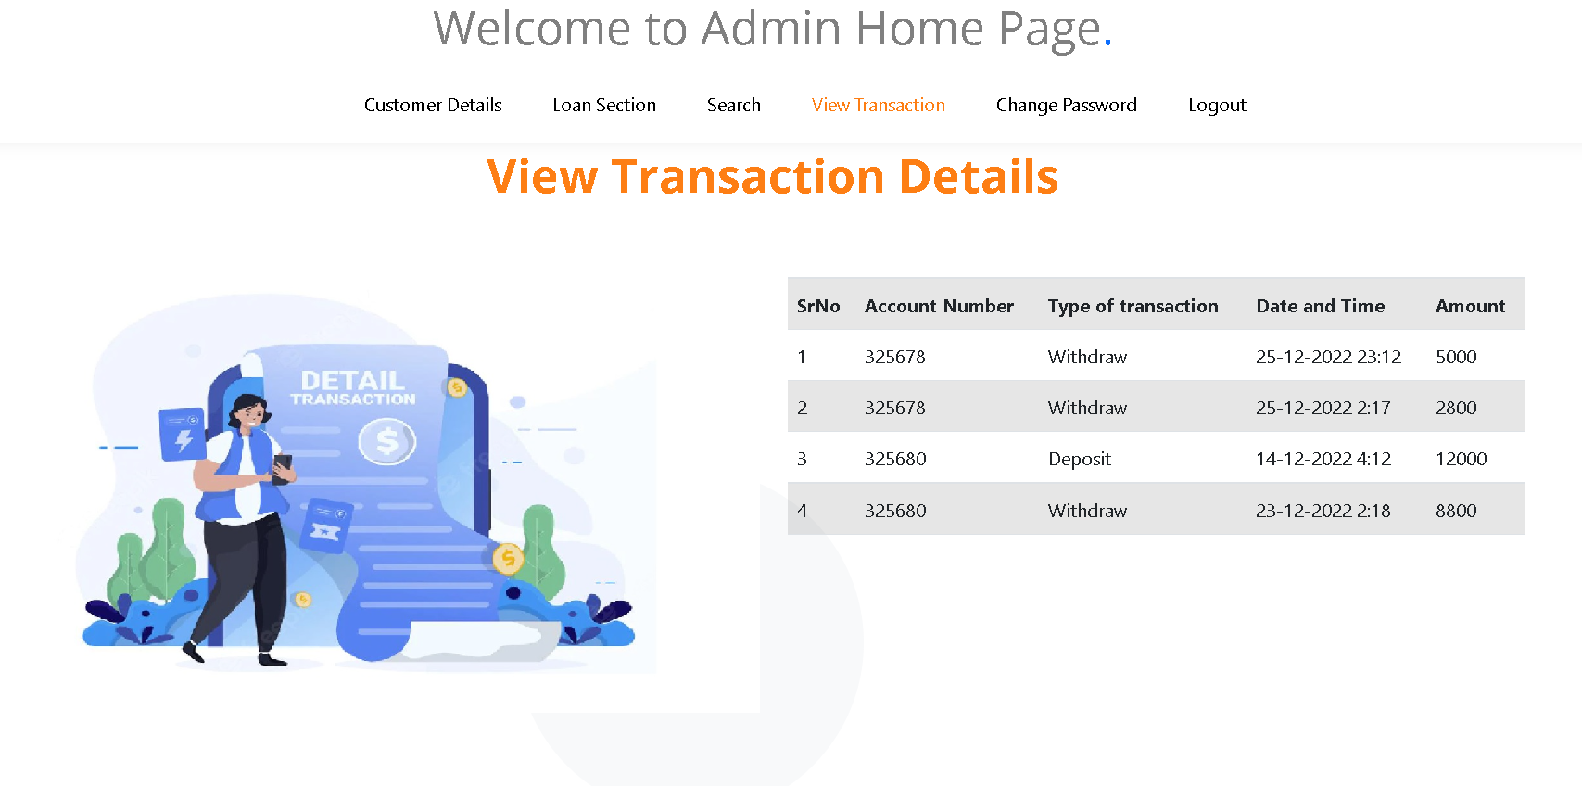
View all customer transaction details

Slide 24
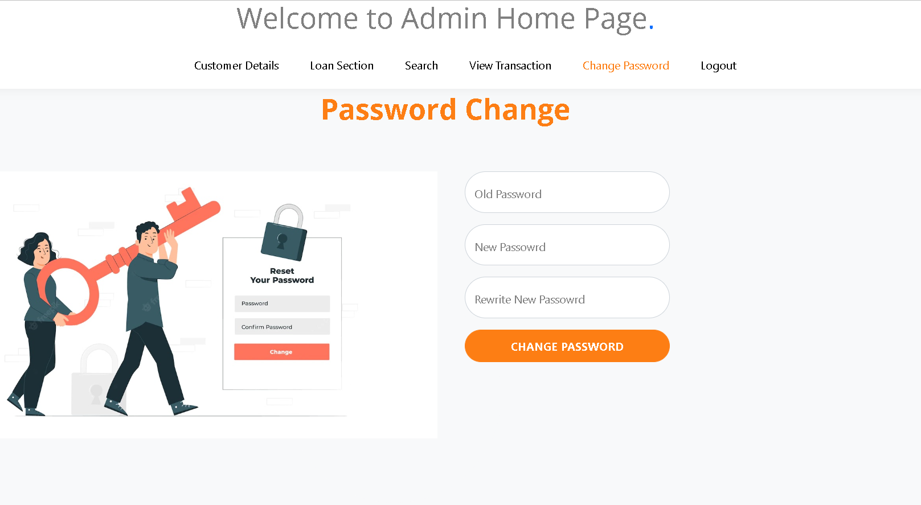
Customer change password

Slide 25
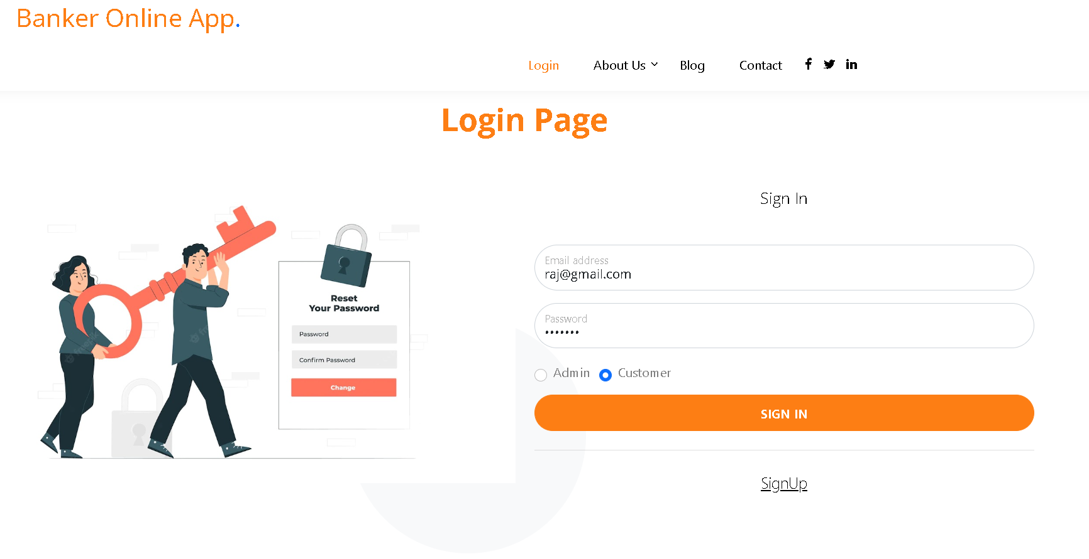
Customer login with email id as raj@gmail.com and password as abc@123

Slide 26
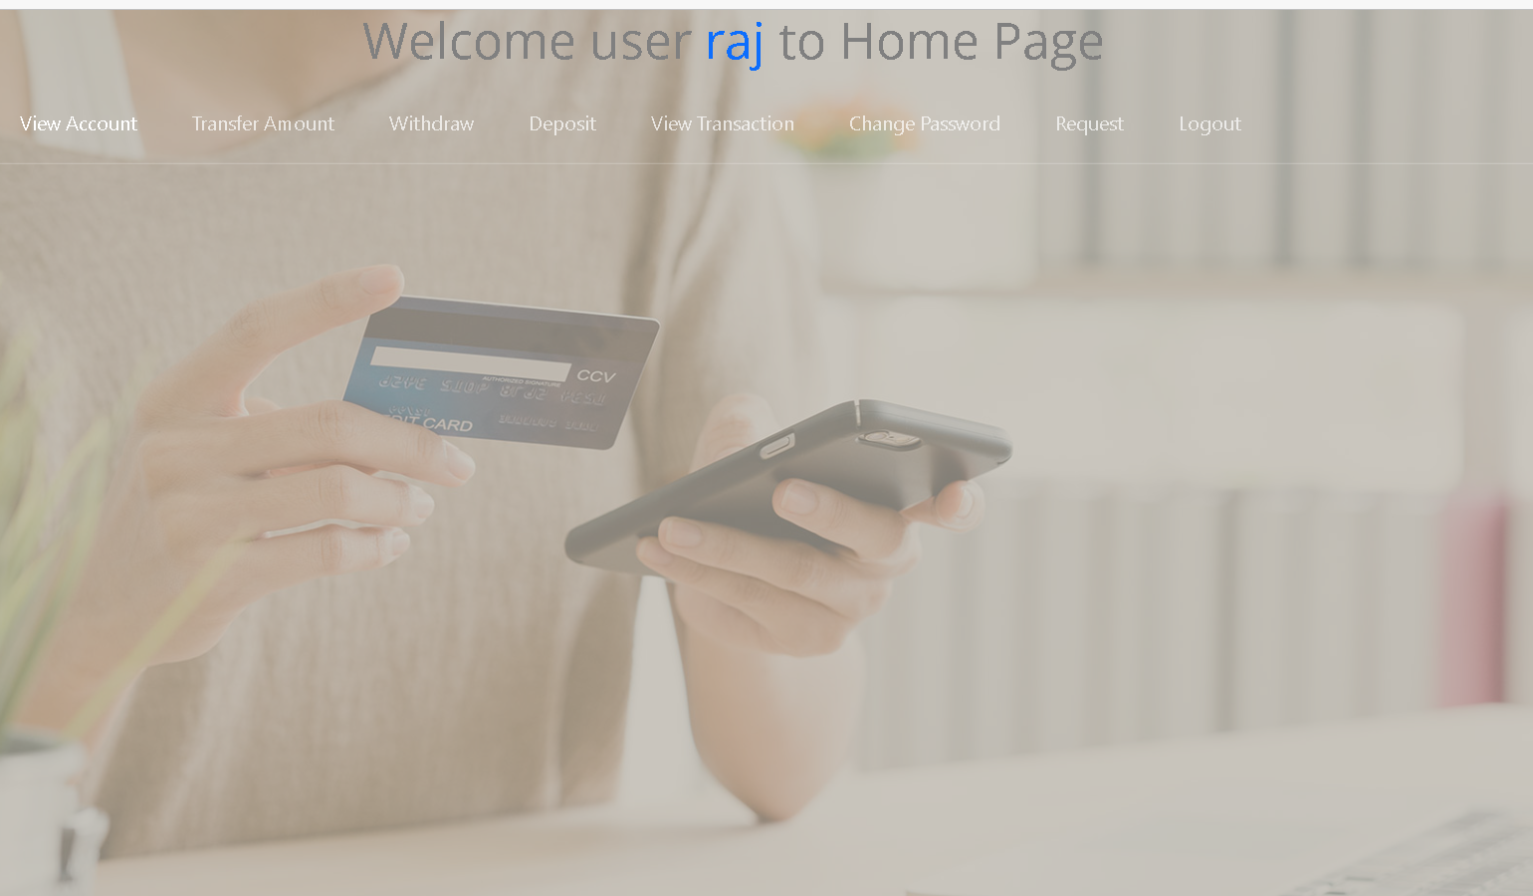
Customer view its own details

Slide 27
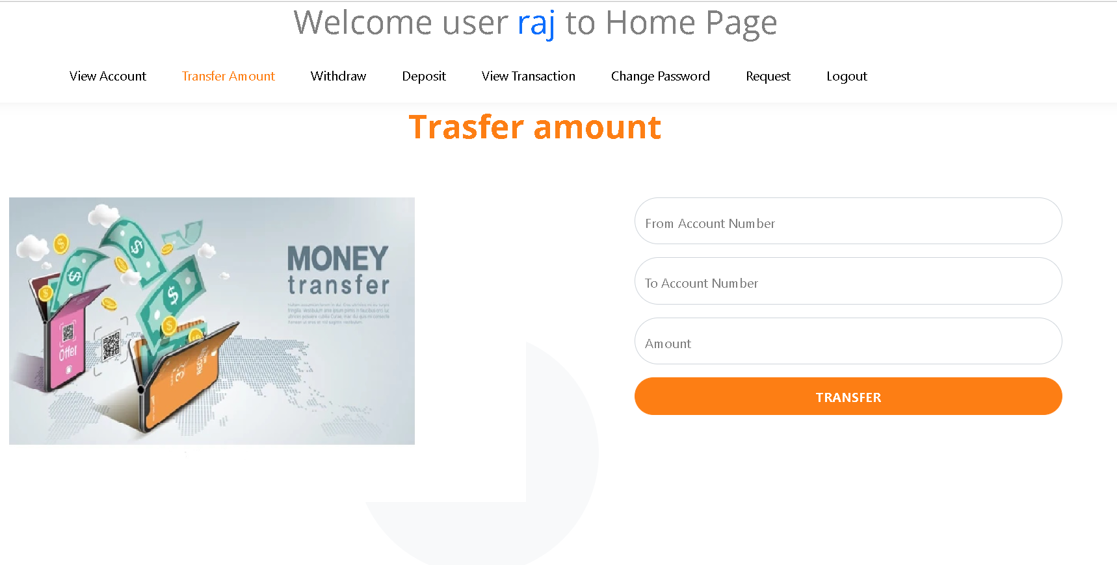
Transfer amount

Slide 28
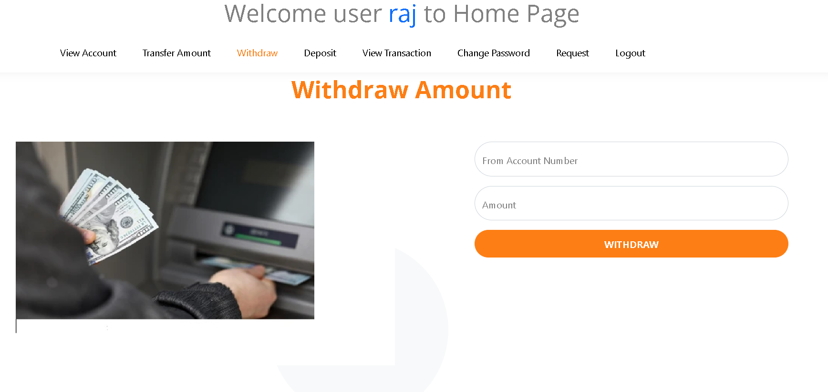
Withdraw amount

Slide 29
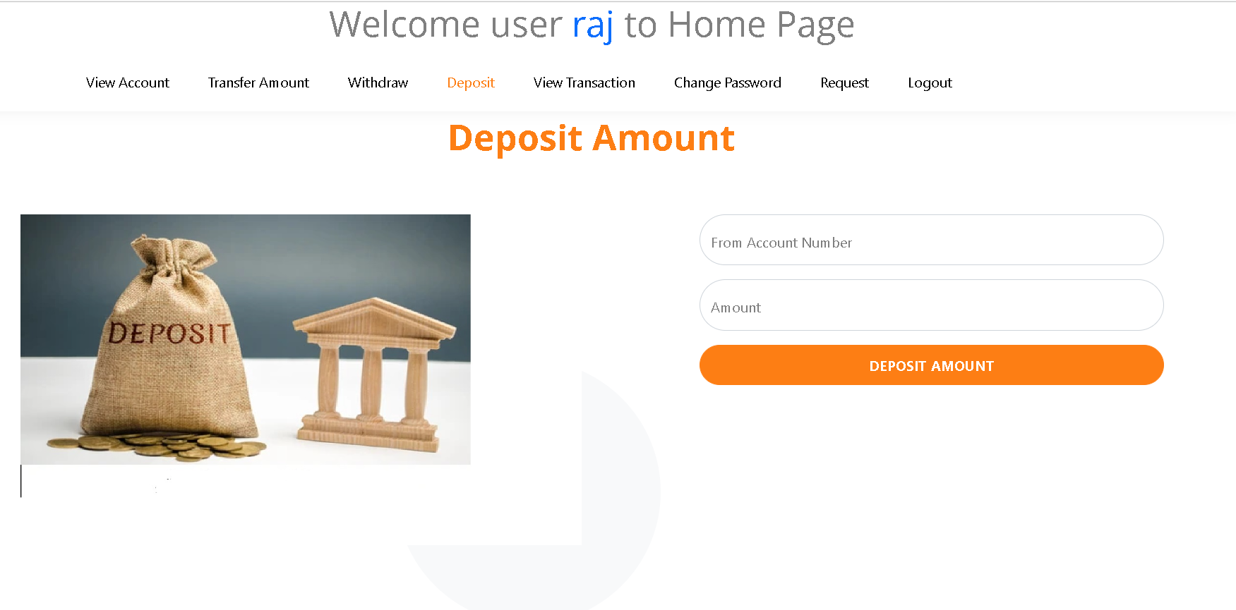
Deposit amount

Slide 30
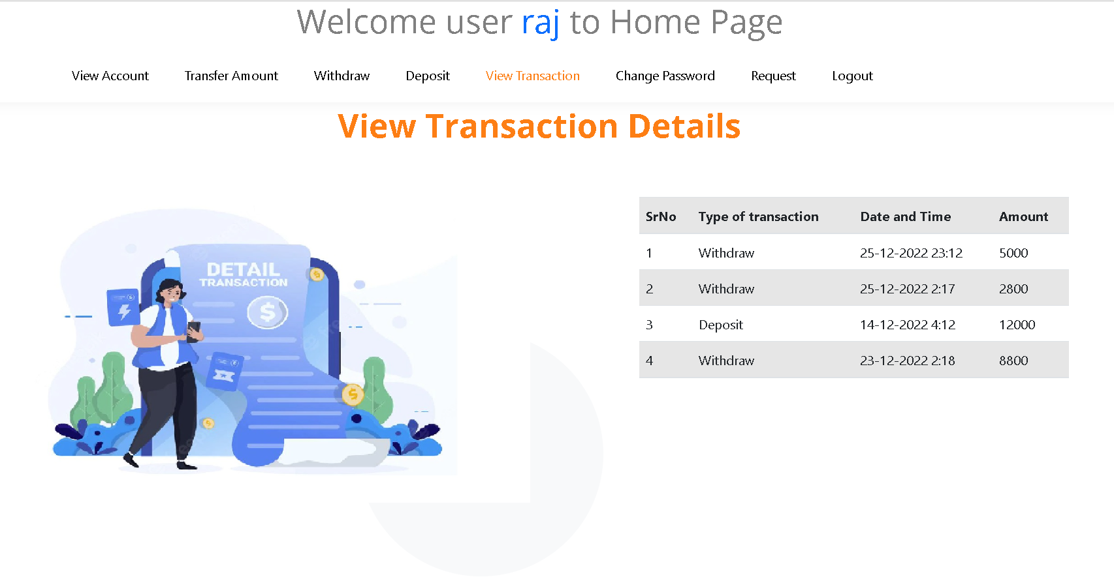
View its own transaction details

Slide 31
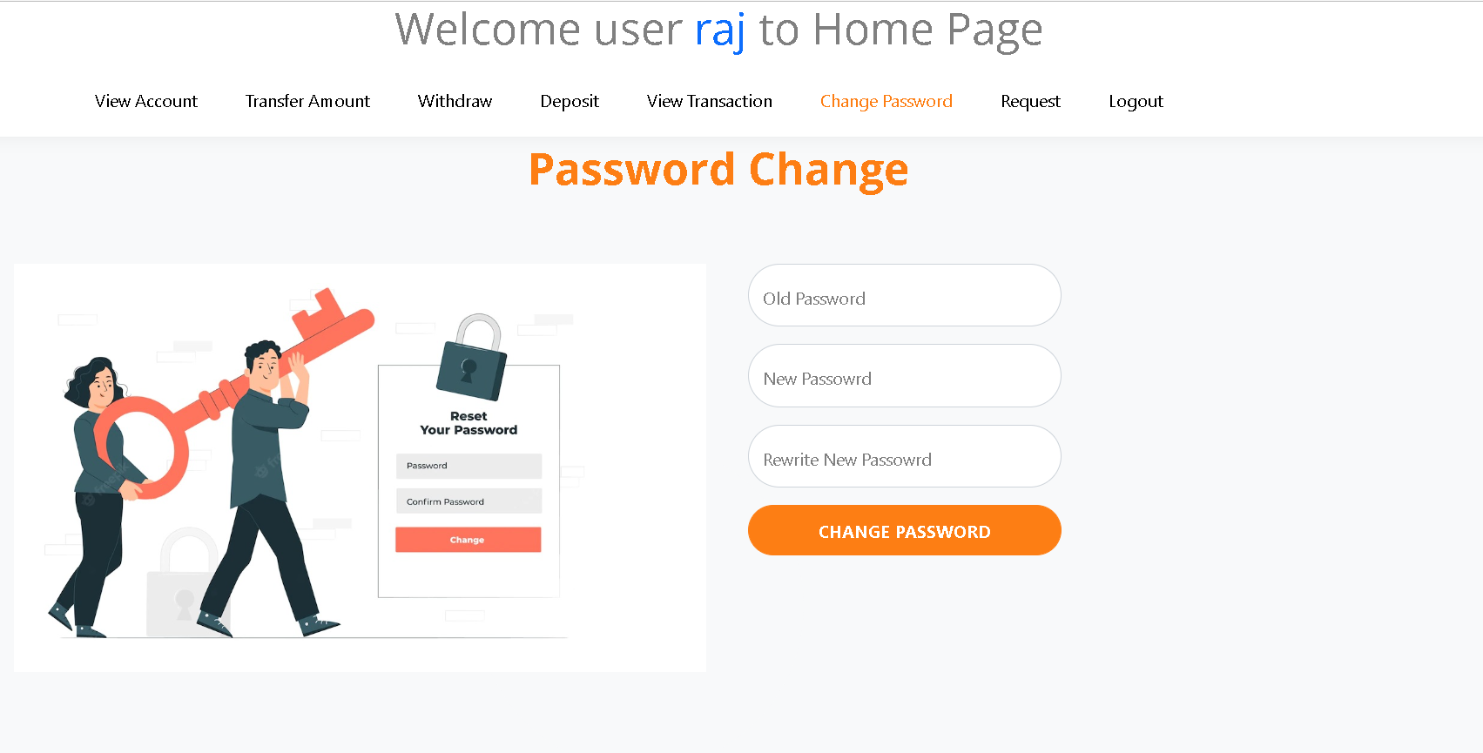
Change password

Slide 32
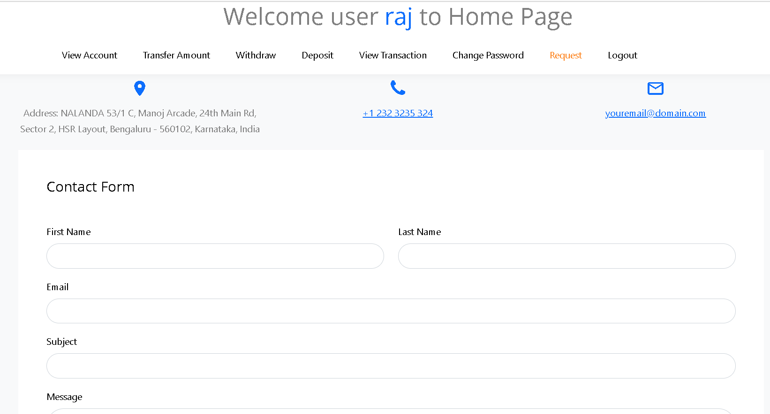
Request from customer to banker

